Slide 1
Course summary

Slide 2
Outline
In this course, we have seen:
Data and data relationships
Asymptotic analysis of algorithms
Various data structures for storing
Ordered/sorted data,
Hierarchically ordered data,
Unordered data, and
Adjacency and partially ordered data,
An introduction to various problem solving techniques

Slide 3
Asymptotic analysis
In asymptotic analysis, we covered:
Little-o, big-theta, and little-omega
Given any two functions of the form we’re interested in, it will always be that exactly one of these three must hold:

Slide 4
Asymptotic analysis
In some cases, however, an algorithm may exhibit behaviour that may be described as “linear or faster” or “no better than n ln(n)”
For these, we use big-O and big-Omega:
We examined basic recurrence relations:
f(n) = 2 f(n/2) + 1 and f(1) = 1 ⇒ f(n) = n + n lg(n)
f(n) = f(n – 1) + n and f(1) = 1⇒ f(n) = ½ n(n + 1)

Slide 5
Asymptotic analysis
We looked at algorithms, namely:
Operations Θ(1)
Function calls
Conditional statements
Loops O(n^{k})
Recursive functions T(n) = T(n/2) + O(n)

Slide 6
Relations
We discussed a number of possible relations between objects:
Linear orderings
Hierarchical orderings
Partial orderings
Equivalence relations
Weak orderings
Adjacency relations

Slide 7
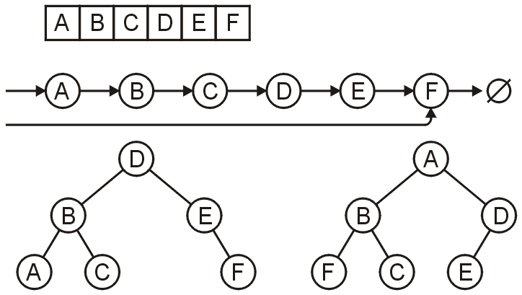
Data structures
For storing linearly ordered data, we examined:
Linear structures:
Tree structures:

Slide 8
Data structures
The linear structures we examined were:
Arrays
Linked lists
Stacks last-in first-out LIFO
Queues first-in first-out FIFO
Deques

Slide 9
Data structures
The tree structures we examined were:
General trees
Binary trees
Binary search trees
AVL trees
B trees
Binary heaps
General and binary trees are useful for hierarchically ordered data

Slide 10
Data structures
For sorting algorithms, we examined:
Algorithm | Run-Time | Memory
Insertion Sort | O(n + d ) | Θ(1)
Bubble Sort | O(n + d ) | Θ(1)
Heap Sort | Θ(n ln(n)) | Θ(1)
Merge Sort | Θ(n ln(n)) | Θ(n)
Quick Sort | Ω(n ln(n)) | Ω(ln(n))
Bucket Sort | Θ(n + m) | Θ(m)
Radix Sort | Θ(n log_{b}(N)) | Θ(n)

Slide 11
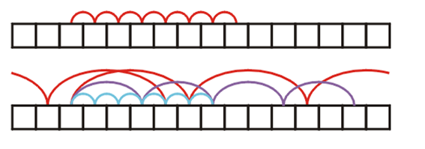
Data structures
For storing unordered data, we examined hash tables
We looked at two styles of hash tables:
Chained hash tables
Hash tables with open addressing
Techniques for collision management with open addressing include:
Linear probing
Double hashing

Slide 12
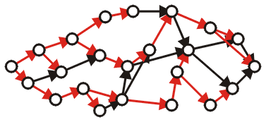
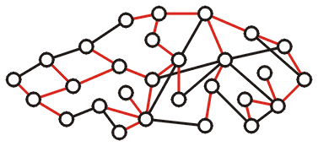
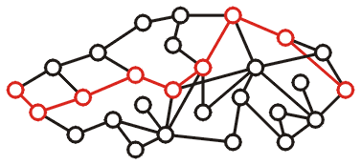
Data structures
With graphs, we examined three common problems:
Finding topological sorts
Finding minimum spanning trees (Prim)
Single-source shortest paths (Dijkstra)

Slide 13
Algorithms
For algorithms, we considered both algorithm design techniques and a quick introduction to the theory of computation:
Greedy algorithms
Divide-and-conquer algorithms
Dynamic programming
Backtracking algorithms
Branch-and-bound algorithms
Stochastic algorithms

Slide 14
Algorithms
We concluded by looking at aspects of the theory of computation:
What can we compute?
The Turing machine
What can we definitely not solve no-matter-what?
The halting problem
What can we solve efficiently?
Deterministic polynomial-time algorithms, NP and NP Completeness

Slide 15
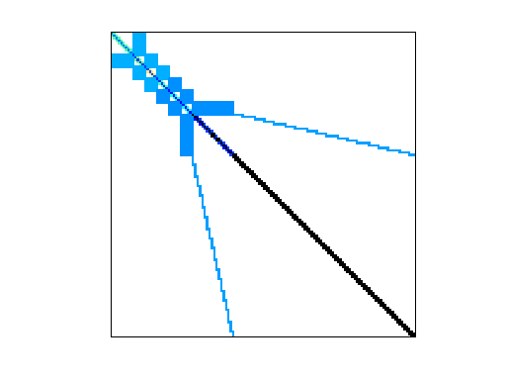
Applications
Finally, we looked at the old-Yale sparse-matrix representation
AMD G3 circuit:
1 585 478 × 1 585 478 matrix
7 660 826 non-zero entries
2 513 732 827 658 zero entries

Slide 16
Back to the Start
On the first day, I paraphrased Einstein:
Everything should be made as simple
as possible, but no simpler.
Hopefully I have shown that, while many data structures and algorithms appear complex, once you understand them, they are much simpler, and often intuitive...

Slide 17
Summary of the Summary
We have covered
A variety of data structures
Considered efficient and inefficient algorithms
Considered various algorithm design techniques
Introduced you to the theory of computation
The efficient storage and manipulation of data will significantly reduce costs in all fields of engineering
More than any other one course, you will see this over-and-over again
Good luck on your exams!

Slide 18
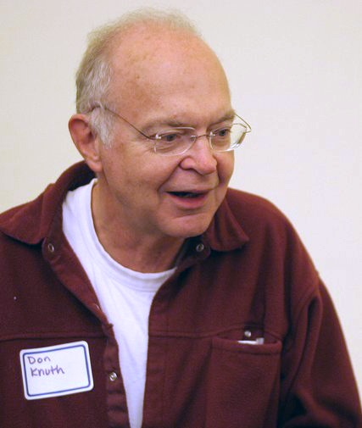
A Few Words from an Old Master…
Are there any questions?
Always remember, however, that there’s usually a simpler and better way to do something than the first way that pops into your head.
Donald Knuth
An algorithm must be seen to be believed.
Donald Knuth
photo by Jacob Appelbaum

Slide 19
References
Wikipedia, http://en.wikipedia.org/wiki/Algorithms_+_Data_Structures_=_Programs
These slides are provided for the ECE 250 Algorithms and Data Structures course. The material in it reflects Douglas W. Harder’s best judgment in light of the information available to him at the time of preparation. Any reliance on these course slides by any party for any other purpose are the responsibility of such parties. Douglas W. Harder accepts no responsibility for damages, if any, suffered by any party as a result of decisions made or actions based on these course slides for any other purpose than that for which it was intended.

